Slide 1
Quality Monitoring of Mangoes
(Dark Patch Detection)
Guided By: Presentation by:
Sourav Bagchi Janumpally Varun Aditya(20IM30007)
Malla Dhanraj(20IM30009)

Slide 2
Project Overview
Problem :
The quality control of mangoes in the food industry is critical to ensure that only the best quality fruit is sold to consumers.
One common issue with mangoes is the presence of dark patches, which can be indicative of disease or rot and negatively impact the appearance and quality of the fruit.
Currently, the process of detecting dark patches in mangoes is manual, time-consuming, and subject to human error.
Objective:
To automate the process of dark patch detection in mangoes by developing an efficient and accurate model that can detect and classify the presence and level of dark patches in images of mangoes.

Slide 3
Specific Requirement
Foreground Extraction
Feature Extraction
Classification of images

Slide 4
Data Given
Plasma Treated Images, Non Treated Images
Excel sheet containing destructive test data

Slide 5
Milestones/Deliverables
Identified a paper on bunch of grapes and another paper on apples, using them as references we are trying to develop the machine learning and deep learning models to satisfy our objective.
We have done the foreground extraction by using the methods:
Using HSV image
Using Watershed segmentation
Using K-Means clustering
Using the above methods, we got a good fit using HSV color space when compared to the other two segmentation techniques. This method also has taken lesser time to extract the background when compared to the other two techniques. Hence, we have decided to use this technique to extract the background of the image.

Slide 6
Milestones/Deliverables
Test Date | Hardness (kg/cm2) | Brix (%) | pH | Titratable acidity (g/ml) | Label
04-08-2021 | 7 | 8 | 2.85 | 2.025 | 0.95
10-08-2021 | 1.3 | 9 | 4 | 1.185625 | 0.9
16-08-2021 | 7.6 | 10 | 3.09 | 1.296 | 0.75
22-08-2021 | 1.2 | 10 | 4.77 | 0.243 | 0.5
28-08-2021 | 1.68 | 10.1 | 4.5 | 0.3675 | 0.3
03-09-2021 | 1 | 12 | 3.68 | 0.607 | 0.1
We have calculated number of pixels whose value is greater than 0 in the image after foreground extraction and divided it with number of pixels we got in the best quality image.
To support this we had done the kernel PCA considering “Titratable acidity”,”pH”,”Brix”,”Hardness” features, obtained weights for 4 features and used those weights and calculated the quality level.
We obtained the decaying curves by plotting above i.e., the percentage of good quality image vs time and using the index obtained from destructive tests vs time..

Slide 7
Milestones/Deliverables
Features to train the model:
We are using three set of features to train the model.
To obtain the first of features, we converted the BGR format of the image to the device independent CIELAB format and obtained 12 set of features using means and standard deviations of the three channels in the new format (L*, a*, b*)
The second set of features we obtained are the percentages p1 and p2 of two clusters in the image.
The third set of feature we are going to use are the operators obtained from the texture of the image.
We are going to combine all the above features to train machine learning and deep learning models.

Slide 8
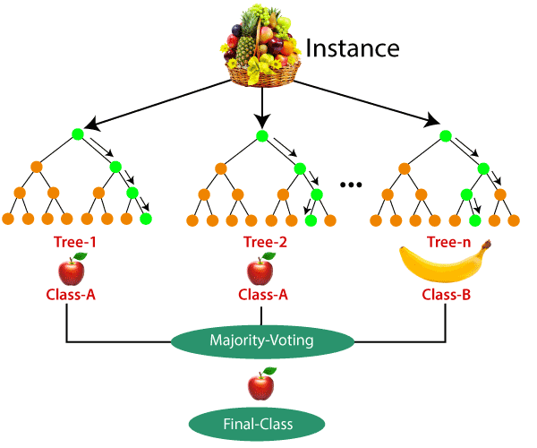
Milestones/Deliverables
Model:
We are going to develop a machine learning and a deep learning model to classify the mangoes based on different quality.
The machine learning models we are deeply interested are Random Forests and Support Vector Machines. We are going to develop both the models and pick the best among the two models using a suitable metric.
The deep learning models(optional) we are interested in are AlexNet, VGG16, ResNet34. SImilarly, we are going to pick the best model among the above three.
We are going to develop an end to end system which can classify the mangoes based on the quality.

Slide 9
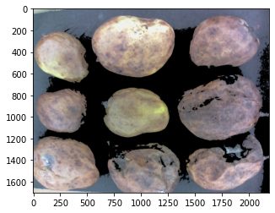
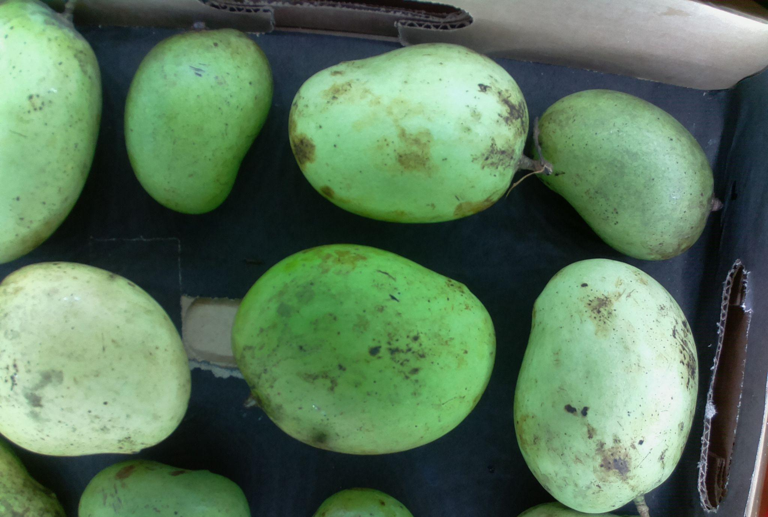
Challenges Faced
Background colour is similar to mangoes especially when dealing with worst quality mangoes.
Due to reflection we faced difficulties while extracting foreground.
The images also included the cardboard which was similar to the colour of worst quality images.
During the operation or testing, the orientation of the mangoes should be almost similar to the images we have, or else there may be errors encountered and the orientation of the camera should be almost fixed.

Slide 10

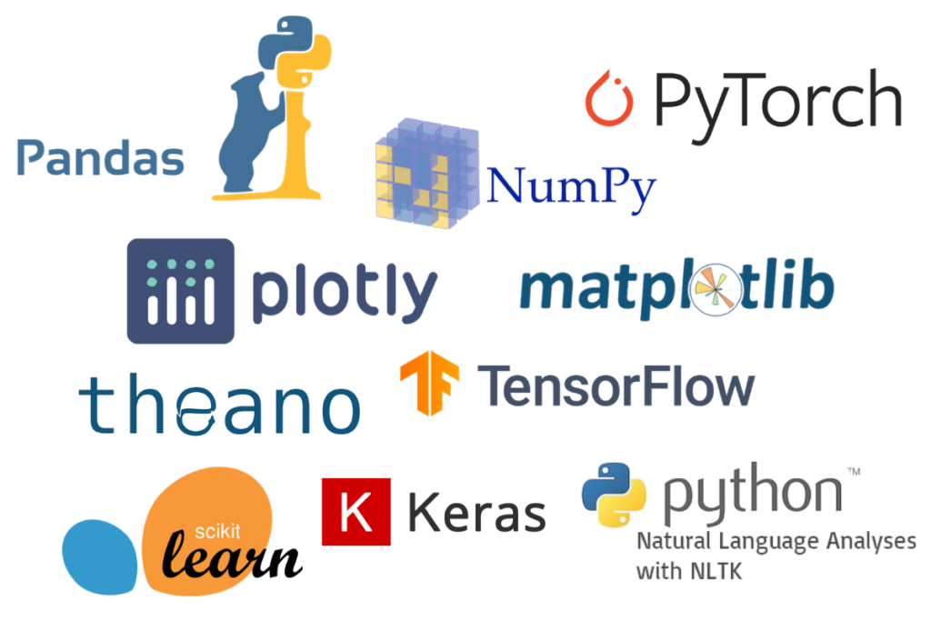
Languages,Libraries
Language : Python
Libraries : Opencv,scikit-image,numpy,pandas,matplotlib,sklearn,os,pathlib,keras, tensorflow.

Slide 11
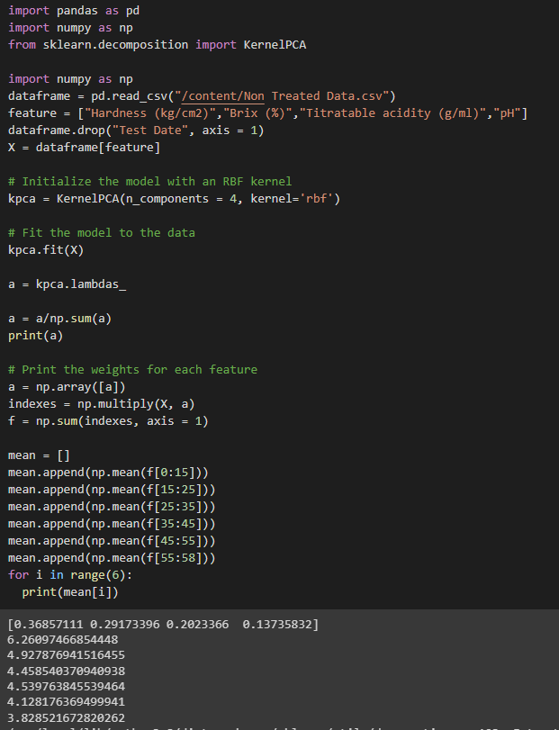
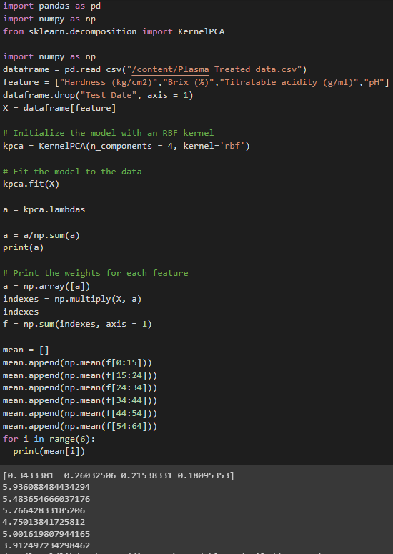
Code walkthrough results
PCA : to support our extraction

Slide 12
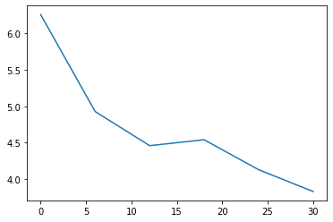
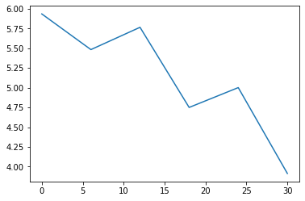
Code walkthrough results
Non treated images 2) Plasma Treated images

Slide 13
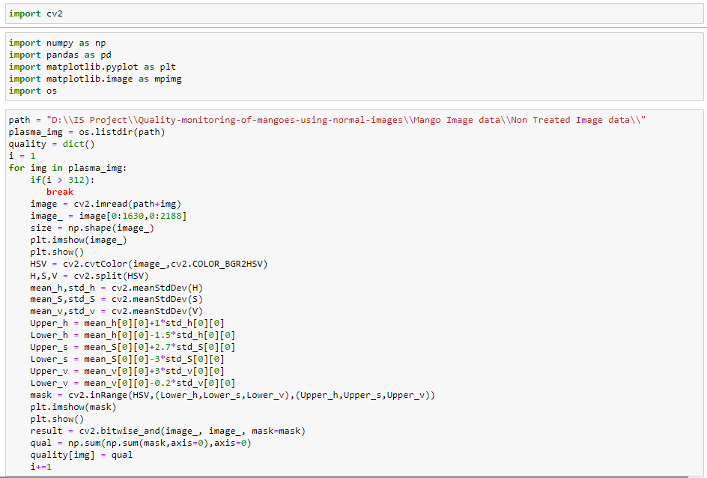
Code walkthrough results
For HSV Foreground extraction:
For Non Treated image:

Slide 14
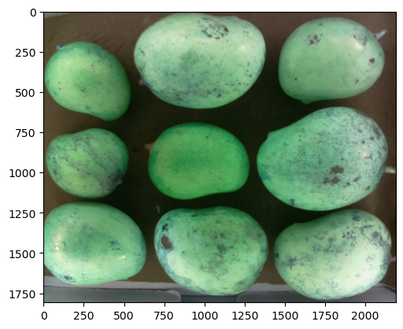
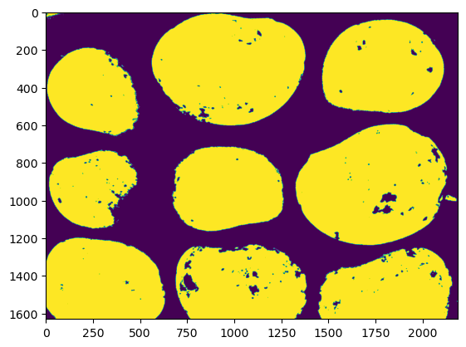
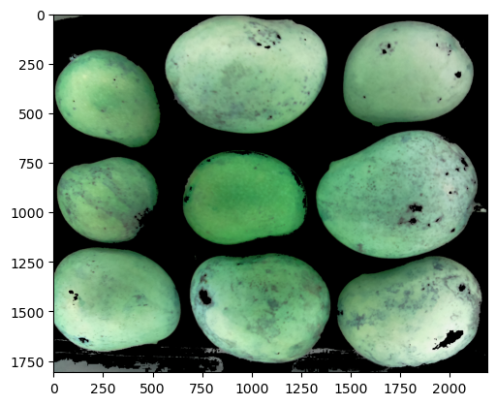
Code walkthrough results

Slide 15
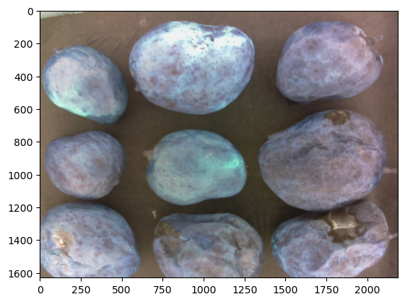
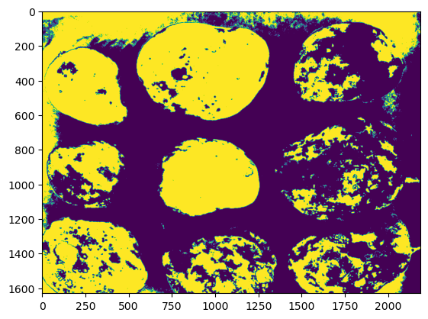
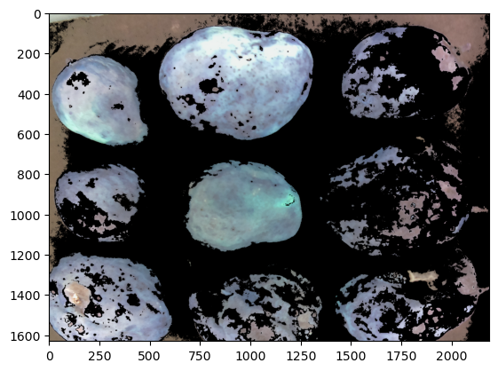
Code walkthrough results

Slide 16
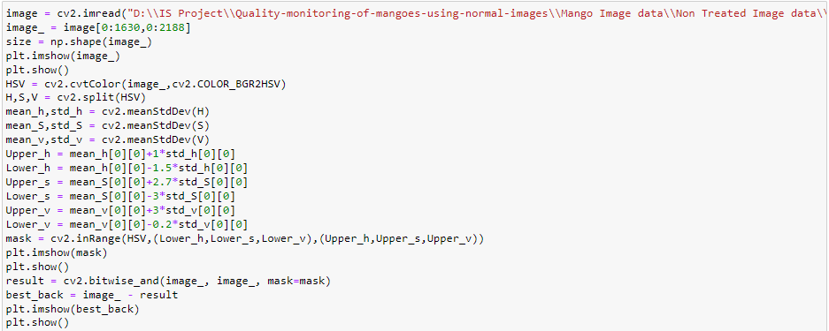
Code walkthrough results
Best Background Extraction

Slide 17
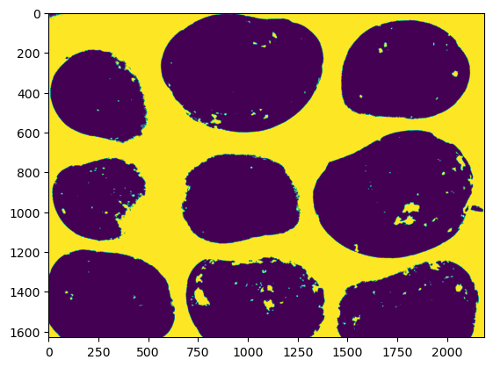
Code walkthrough results
Original image 2) Mask of best image 3) Best Background

Slide 18
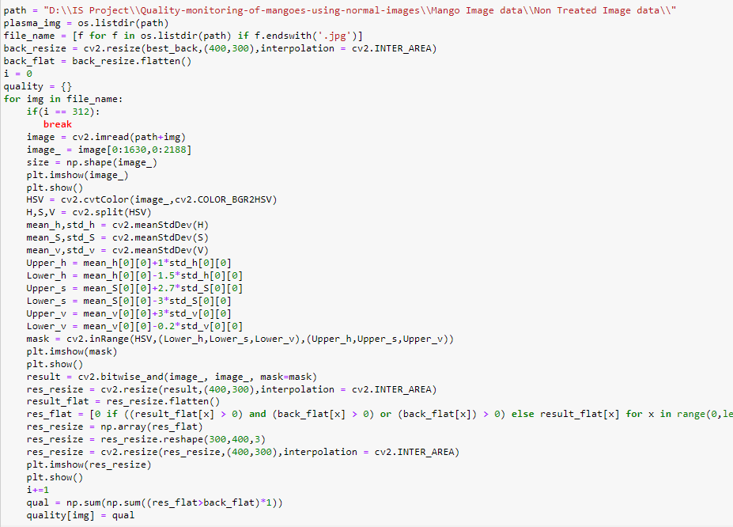
Code walkthrough results
Removing background with help of best background

Slide 19
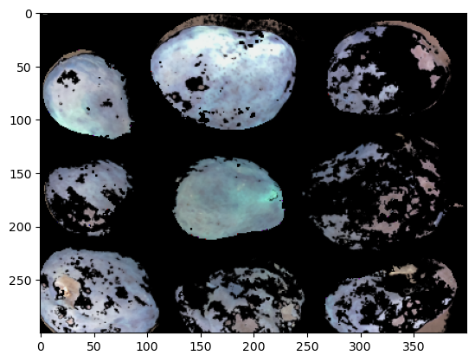
Code walkthrough results

Slide 20
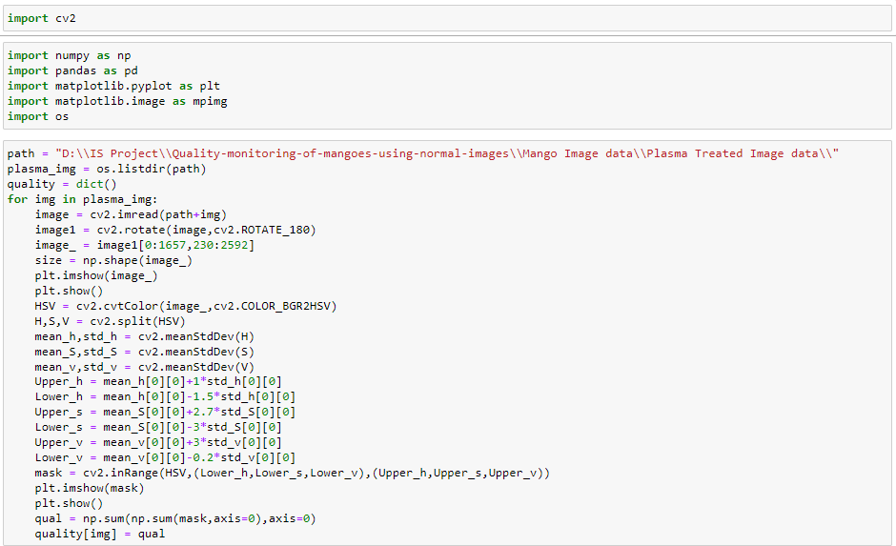
Code walkthrough results
Similarly we have did for Plasma treated images

Slide 21
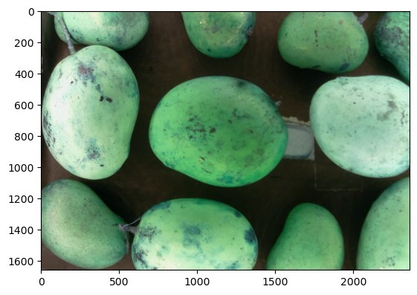
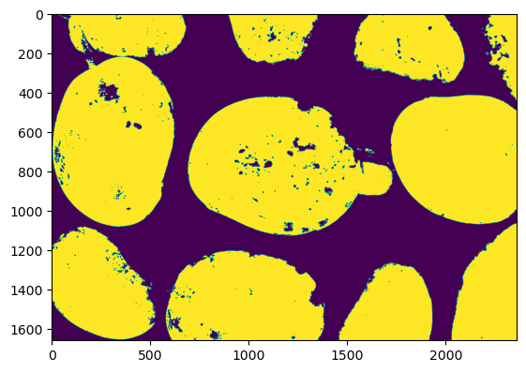
Code walkthrough results

Slide 22
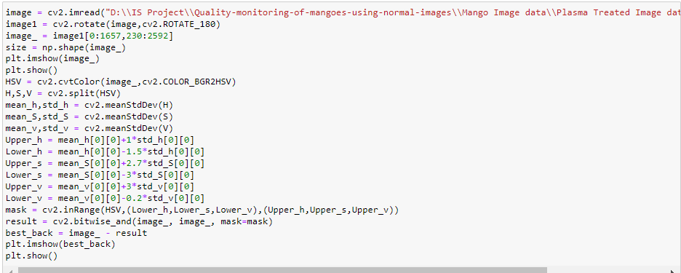
Code walkthrough results

Slide 23
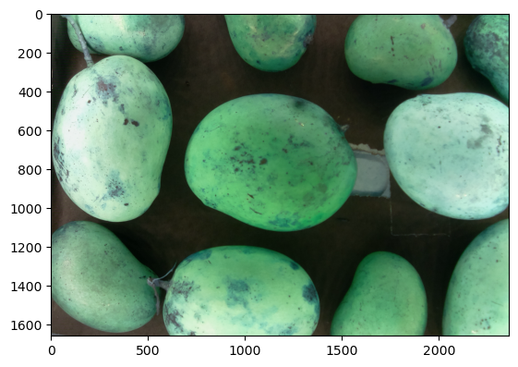
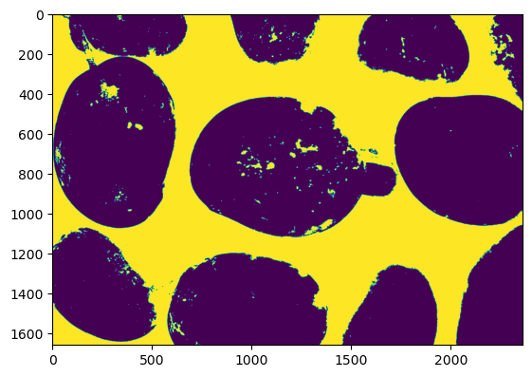
Code walkthrough results

Slide 24
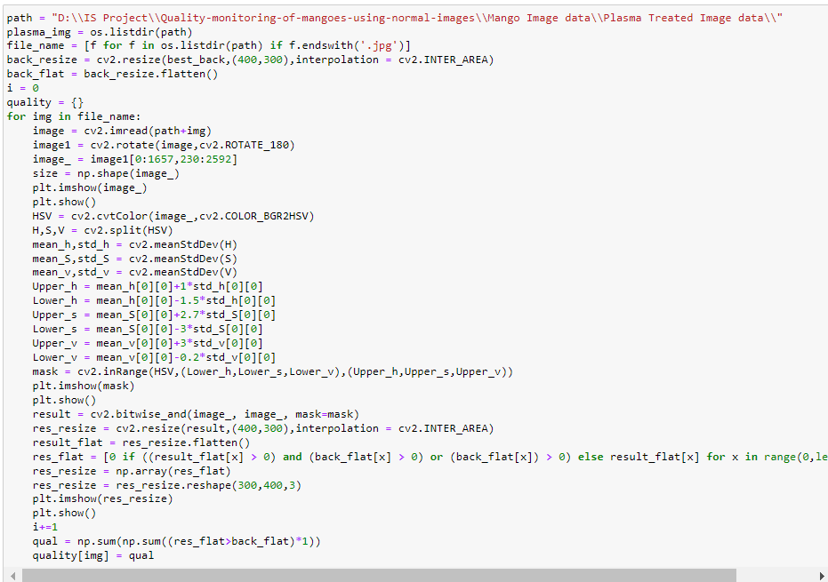
Code walkthrough results

Slide 25
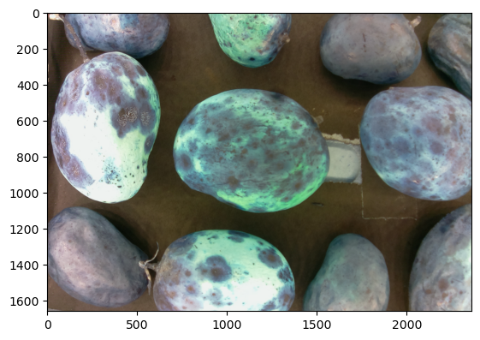
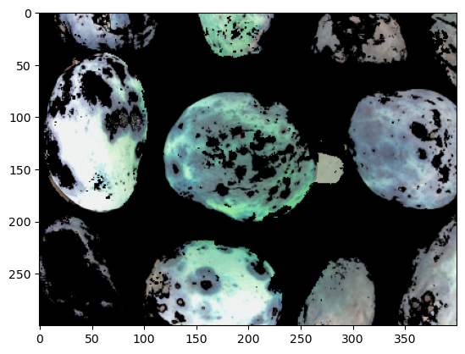
Code walkthrough results

Slide 26
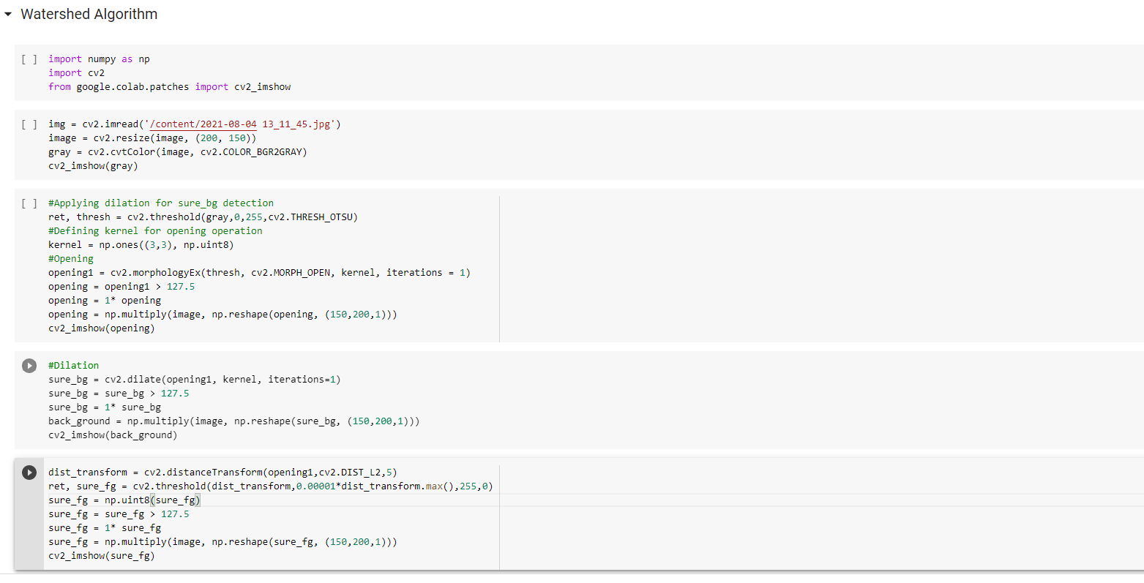
Code walkthrough results

Slide 27
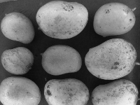
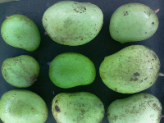
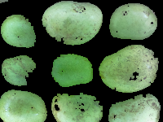
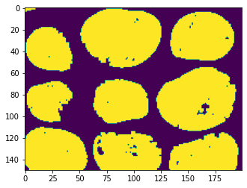
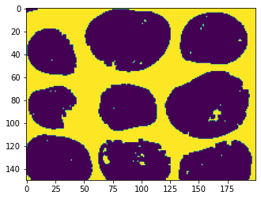
Code walkthrough results

Slide 28
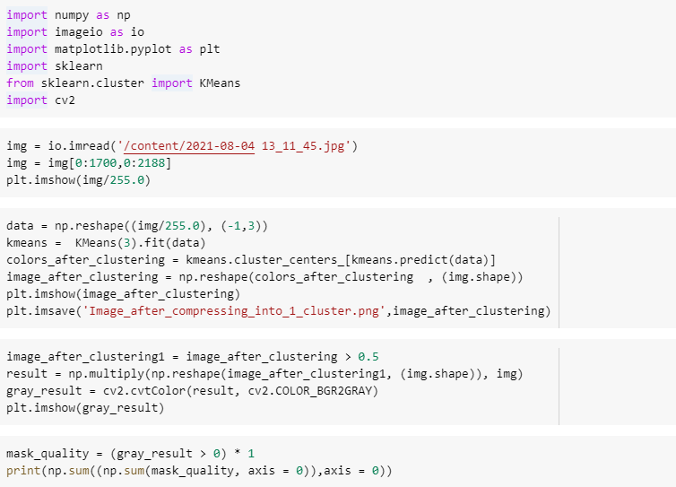
Code walkthrough results
K-means Clustering:

Slide 29
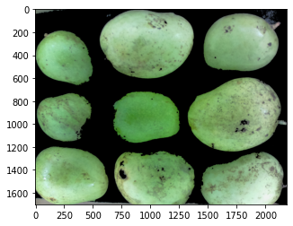
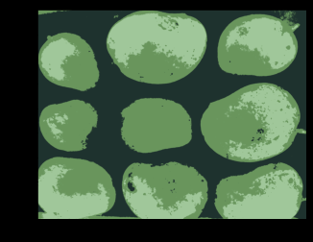
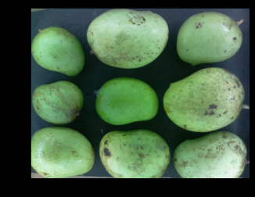
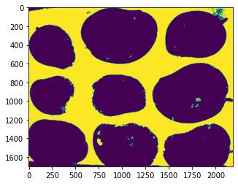
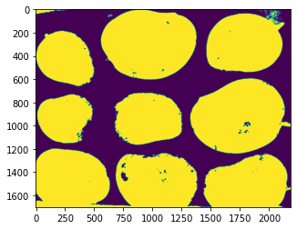
Code walkthrough results (for the best image)

Slide 30
Features
Features to train the model:
We are using three set of features to train the model.
To obtain the first of features, we converted the BGR format of the image to the device independent CIELAB format and obtained 12 set of features using means and standard deviations of the three channels in the new format (L*, a*, b*)
The second set of features we obtained are the percentages p1 and p2 of two clusters in the image.
The third set of feature we are going to use are the operators obtained from the texture of the image.
We are going to combine all the above features to train machine learning and deep learning models.

Slide 31
First Set of Features
To obtain the first of features, we converted the BGR format of the image to the device independent CIELAB format and obtained 12 set of features using means and standard deviations of the three channels in the new format (L*, a*, b*)
The obtained or extracted features were the means and standard deviations of three channels (L*, a*, b*) and combinations of these.
Features are:
mean(L*), mean(a*), mean(b*), std(L*), std(a*), std(b*), mean(a*)*mean(b*), mean(L*)*mean(a*), mean(L*)*mean(b*), mean(a*)/mean(b*), mean(L*)/mean(a*), mean(L*)/mean(b*)

Slide 32
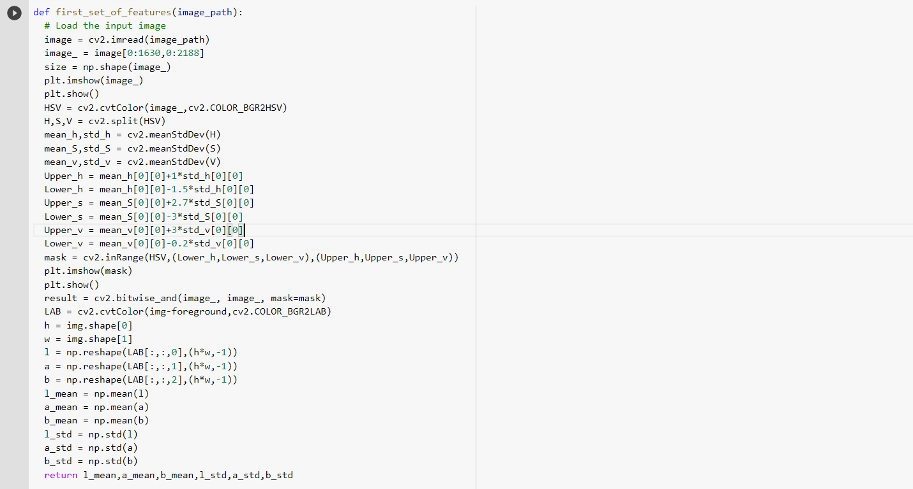
Code walkthrough

Slide 33
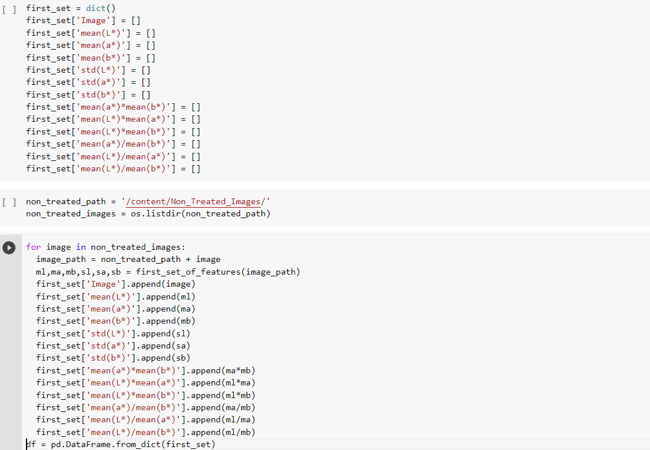
Code walkthrough

Slide 34
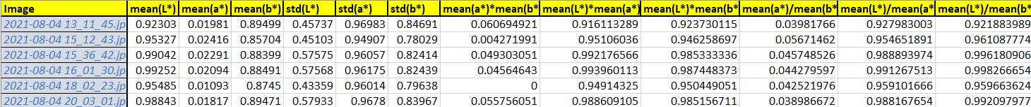
Features (Non-treated Images)
Normalized features

Slide 35
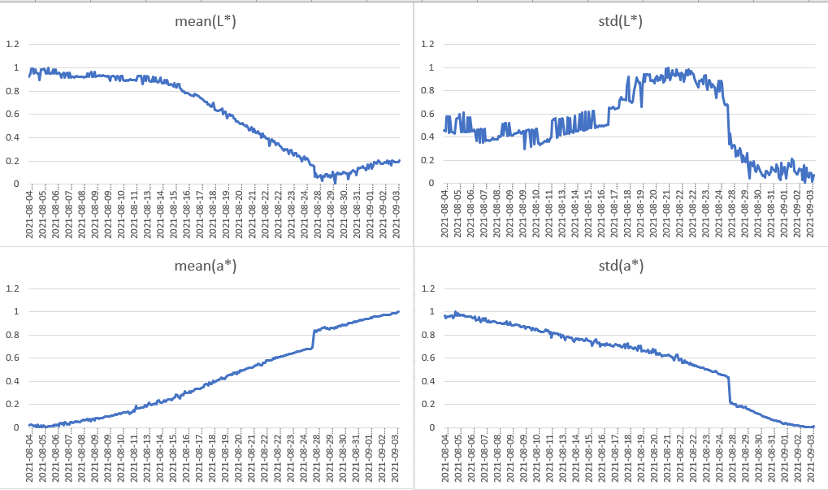
Feature plots (first set of features)

Slide 36
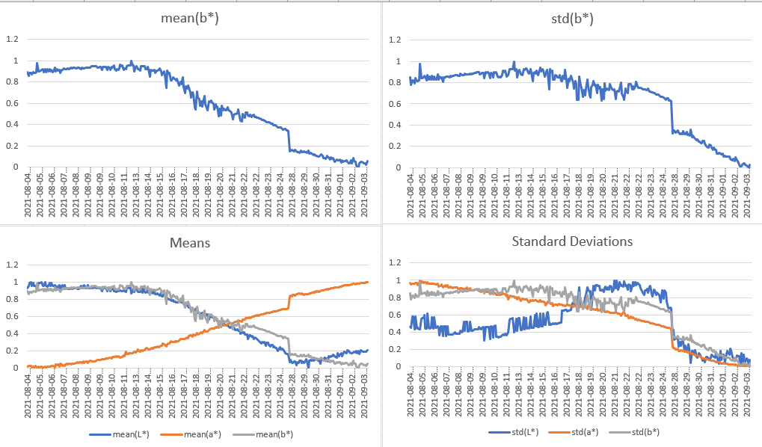
Feature plots (first set of features)

Slide 37
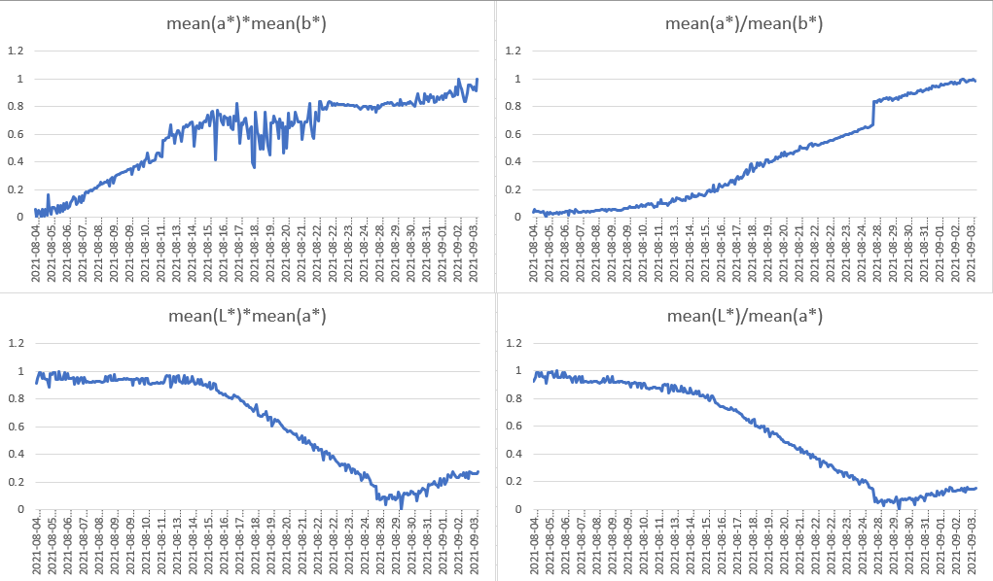
Feature plots (first set of features)

Slide 38
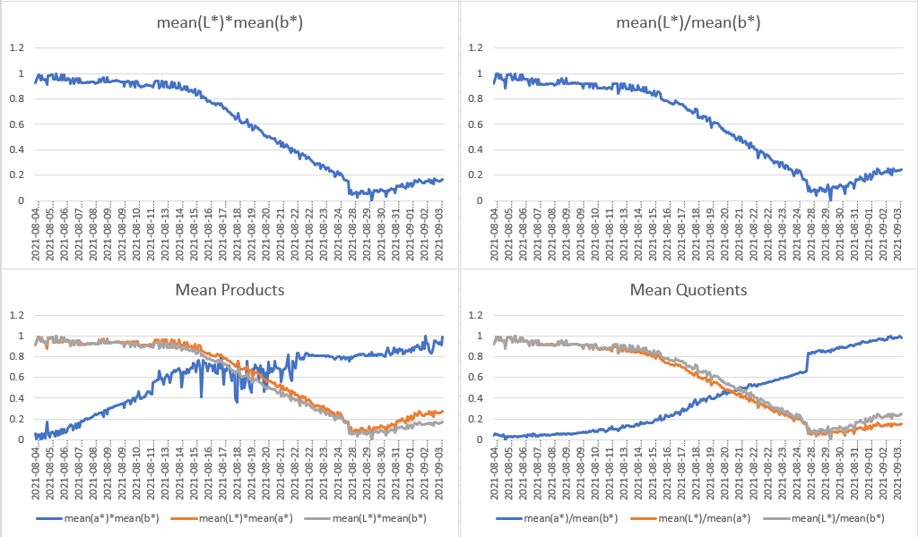
Feature plots (first set of features)

Slide 39
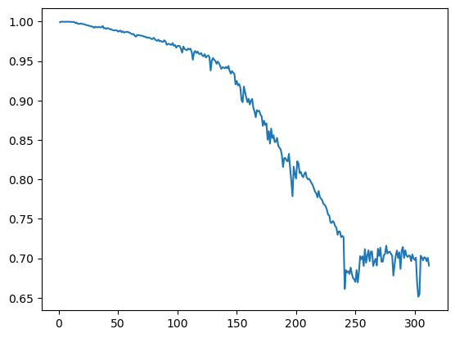
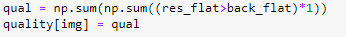
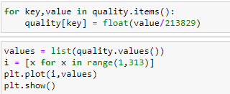
Second Set of Features
Second set of features are percentages of black patches(p1) and percentage of good mangoes quality(p2)

Slide 40

Second Set of Features
Plasma Treated

Slide 41
PCA Plots
Non treated images 2) Plasma Treated images

Slide 42

Second Set of Features
Non- treated (using K-means segmentation)

Slide 43

Second Set of Features
Plasma- treated (using K-means segmentation)

Slide 44

Texture Extraction for Third Set of Features

Slide 45

Code walkthrough results

Slide 46
Feedback from TA
First he told us to extract foreground and then asked us to find the percentage of black pixels.
Then, he asked us to extract features in which we have extracted two set of features , he is convinced with the work in feature extraction we had done and told us to proceed with third set of features based on texture
We have obtained texture but we have to obtain features from texture.

Slide 47
Further plans
Obtaining features from texture
Training a classifier by using the features obtained
We have thought to develop two models and take the best model from the two

